Slide 1
BARDA DRIVe’s ENACT Program
Šeila Selimović, PhD
Director, ENACT Program
Digital Medicine Society
September 9, 2020

Slide 2
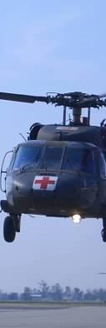
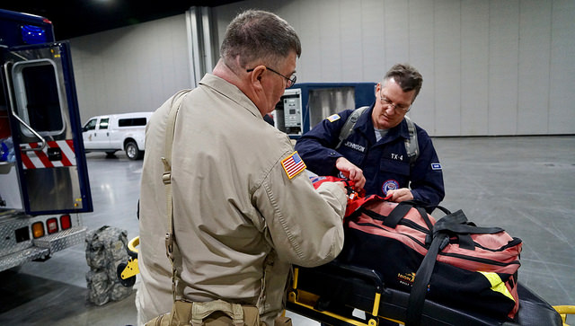
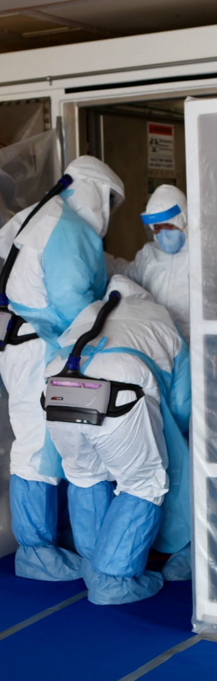
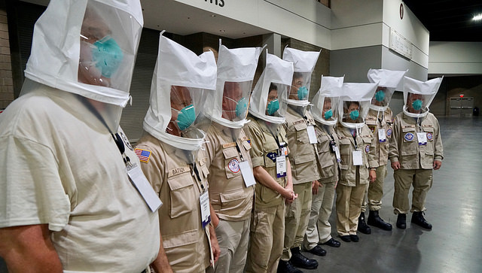

ASPR Mission
Save Lives and Protect Americans from 21st Century Health Security Threats
Notes:
Simply put, the mission of the Assistant Secretary for Preparedness and Response is to “Save Lives and Protect Americans from 21st Century Health Security Threats”.

Slide 3


The BARDA Model
Flexible, nimble authorities
BARDA develops and makes available medical countermeasures (MCMs) by forming unique public-private partnerships to drive innovation off the bench to the patient to save lives.
Promote innovation
Multi-year funding
Facilitate partnerships
Cutting edge expertise
Notes:
As I said before,
BARDA was created to foster public-private partnerships to accelerate the development of lifesaving tools and technologies to detect, prevent, mitigate and recover from threats to our national health security.
We are grateful to congress for the support and special authorities that enable us to lead our mission.
While these authorities that form the foundation of the BARDA Model are essential…
it is the sum total of our partnerships that make us all successful in what we do.

Slide 4




BARDA Program Divisions
Medical Countermeasures (MCM) Program
Influenza & Emerging Infectious Diseases
Chemical, biological, radiological and nuclear (CBRN) Program
Detection, Diagnostics, & Device Infrastructure
Pharmaceutical Countermeasure Infrastructure
Division of Research, Innovation, and Ventures (DRIVe)

Slide 5


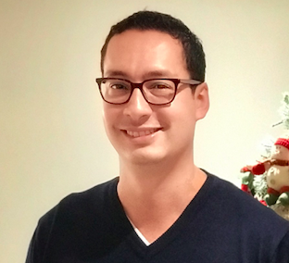
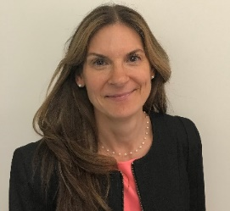

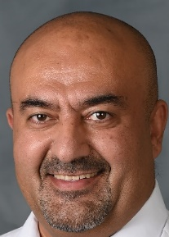


Šeila Selimović, PhD
Director, ENACT Program
ENACT@hhs.gov
seila.selimovic@hhs.gov
Carlos Arguello-Ortiz
PhD
Senior Data Scientist (CTR)
Jane Bearinger PhD
Senior Consultant / SME (CTR)
Dev Mittar
PhD
Program Officer
Pejman Naraghi-Arani
PhD
Senior Consultant / SME (CTR)
Shanita Rowland
MPH
Senior Consultant
(CTR)
Carlisle Runge
Quantitative Analyst / Consultant (CTR)

Slide 6
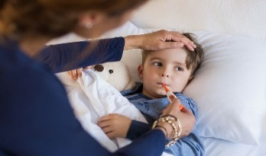
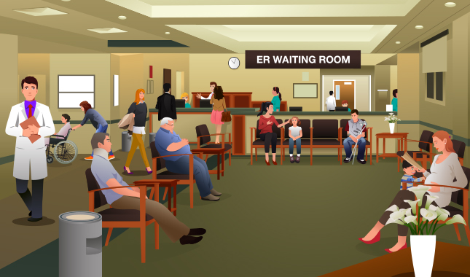
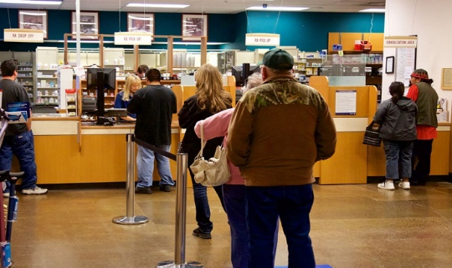
Traditional healthcare paradigm
SYMPTOMS
DIAGNOSIS
TREATMENT
Difficult to differentiate illness
Patient can be a transmission vector before noticeable symptoms
Appointment with healthcare provider
Wait at clinic or emergency room
Filling prescriptions
Many treatments work best when given early
Costs to the community
Delays cause burden to healthcare system
Loss of productivity
For infectious disease: risk of transmission and spread in the community; lack of resources
Cost to the individual
Long wait times
Prolonged illness
Risk of disease progression
Notes:
Many diseases share similar symptomatology
Prodromal period is one of the four major stages of a disease. The first stage is referred to as the incubation period followed by a prodromal period. At prodromal period, the symptoms may not be very specific or severe. The affected person can still perform usual functions although distress or discomfort may be felt.

Slide 7

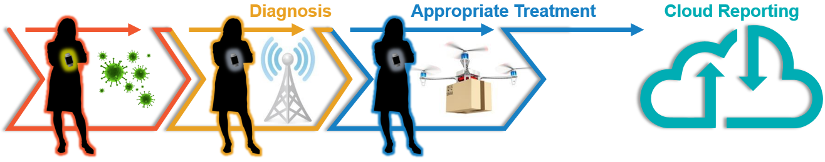
Supporting pathogen-agnostic technologies that enable earlier infection detection:
Empowering individuals to take early action on their health.
Providing early actionable information to medical care providers; patient triage.
Following the spread of an epidemic in near real-time.
Treat –
Early diagnostics for medical care providers
Treat –
Does the patient have a viral or bacterial infection?
Control –
Actionable information for public health organizations
Act –
Pre-symptomatic information: Empowering patients
Control –
Next hot spot? Can hospitals allocate their resources?
Act –
Should I take a sick day and see a doctor today?
Notes:
“Enable triggers for home testing that is being supported by diagnostics division”
“Enhance the efficacy of clinical trials by enabling passive monitoring of health status of participants”

Slide 8
Act –
Pre-symptomatic information:
Empowering patients
Can infectious disease be detected inside the body prior to the onset of noticeable symptoms – using minimally invasive techniques?
Does a “health” signature exist – for an individual or across population groups?
If so, is the signature similar across any given population group (by age, biological sex, ethnicity, health status, behavior status (e.g. activity level; smoking etc.)?
Does a concrete “illness” signature exist for an individual or across population groups?
Does the signature depend on the type of infection?
What is the time period between onset of the “illness” signature and obvious symptoms?
Notes:
Question: Can we predict onset of infectious disease pre-symptomatically using minimally invasive methods?
Do “Health/Illness” signatures amenable to minimally invasive techniques exist?
What is the predictive value of any signature that may be identified?
Does it work across age/sex/other demographics?
Does it provide signals hours or days prior to symptom onset?

Slide 9
Control –
Next hot spot? Can hospitals allocate their resources?
How can early infection information be useful to health care organizations: pharmacies, hospitals, health departments?
Can wearable sensors and telehealth solutions provide now-casting of infectious disease incidence?
Can these technologies distinguish between infections caused by different pathogens?
Notes:
Question: Can we predict onset of infectious disease pre-symptomatically using minimally invasive methods?
Do “Health/Illness” signatures amenable to minimally invasive techniques exist?
What is the predictive value of any signature that may be identified?
Does it work across age/sex/other demographics?
Does it provide signals hours or days prior to symptom onset?

Slide 10
Treat –
Early diagnostics for medical care providers
Can infectious disease be detected / determined based on the host response and through on-demand tests?
Do viral and bacterial infections provide different physiological and biomarker signatures?
Can actionable infection information be provided early to the medical care provider?
Notes:
Question: Can we predict onset of infectious disease pre-symptomatically using minimally invasive methods?
Do “Health/Illness” signatures amenable to minimally invasive techniques exist?
What is the predictive value of any signature that may be identified?
Does it work across age/sex/other demographics?
Does it provide signals hours or days prior to symptom onset?

Slide 11
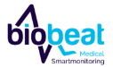











ENACT Investment Areas - Vision
Act –
Pre-symptomatic information: Empowering patients
MICRONEEDLE
Treat –
Early diagnostics for medical care providers
LAB-ON-A-DUST
Control –
Actionable information for health care organizations
Notes:
Technologies:
1.) Non-invasive health monitoring: smart devices (Spire washable tag, Biobeat watch, Empatica wristband)
2.) Non-invasive health monitoring: Smart app (Evidation)
3.) On-body continuous monitoring devices (Sonica sticker, EnLiSense band, Stanford Medicine microneedle patch, UC San Diego wearable focused ultrasound system
4.) In-home monitoring (Sound Life Sciences)
5.) Telehealth (98point6)
6.) Point-of-care / on-demand analysis (Rizlab Health cytotracker, Stanford Medicine Lab-on-a-Dust, GE Healthcare ultrasound detector)

Slide 12
ENACT Portfolio: Sensing Mechanisms
12%
16.7%
5.6%
5.6%
5.6%
5.6%
28%
22%
(Percentages are rounded off.)

Slide 13
ENACT Portfolio: Biophysical Markers
10%
5%
25%
5%
10%
5%
20%
20%

Slide 14

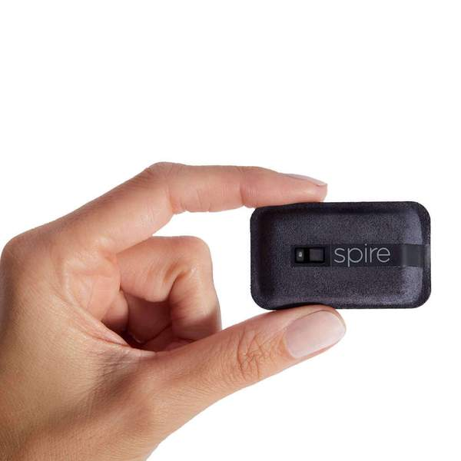

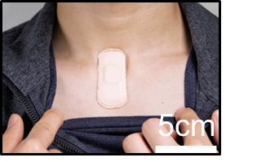
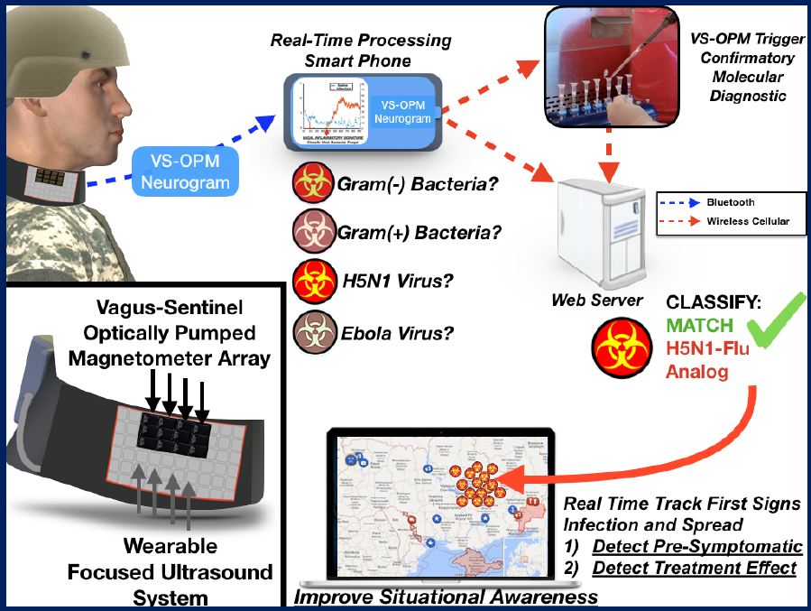

Biophysical Continuous Monitoring Devices
wearable focused ultrasound system
Respiration rate tracking equivalent to medical grade monitoring
Heart rate and heart rate variability
Sleep / sleep quality
Activity
Stress
Vagus nerve firing indicates immune system status
Bacterial vs viral infections
Detects pre-symptomatic infection
Detects treatment effect
Real-time tracking
Acousto-mechanic sensing
Assesses cardio-pulmonary health
Vital sign monitoring
Notes:
I would differentiate Slide 9 (Purely Biophysical continuous monitoring) from Slide 11 (Bio chemical continuous monitoring) and group Sonica and UCSD with Spire, BioBeat and Empatica
Sonica: Advanced, acoustomechanic (ADAM) system provides comprehensive assessment of cardiopulmonary health employing low power, in-sensor analytics & cloud integration.
ADAM’s full suite of digital biomarkers:
1) Predict for impending respiratory infection
2) Warn of continued infectiousness
3) Identify treatment non-responders
4) First responders can apply patch for continuous vital sign monitoring
UC San Diego: Low-profile wearable device that can be worn on demand
Measuring changes in vagus nerve firing indicates immune system status and activation
Device is envisioned to detect pre-symptomatic infections anywhere in the body
Allow individuals to monitor themselves for signs of impending disease
Allow clinicians to monitor patients after discharge for infection
Enhance capabilities of first responders to monitor patients in transit
Ge: StimResponse: Novel Ultrasound Immune Response Profiling Tool for Pre- symptomatic Pathogen Exposure Detection
Concept: Non-invasive ultrasound test will detect pre-symptomatic exposure to pathogens via development of stress model involving biomarker signatures and stimulation inputs.
No biological sample required.
Ultrasound to different body locations drives different immune cell response profiles
Expanding use of technology from therapeutic (DARPA) to diagnostic (BARDA)
Biomarkers measured before and after ultrasound on subjects exposed to LPS, flu and pneumonia (multiple time points; non-exposed control subjects)
Stanford (middle):
Microneedle patch coupling electrodes to structure-switching aptamers.
Continuously monitors CRP, Glucose, IP10, TRAIL in the interstitial fluid
Can monitor multiple biomarkers once every 5 min. for up to 2 weeks
Enables pre-symptomatic monitoring and drug dose management in clinical trials or patient treatment/Emergency responders

Slide 15


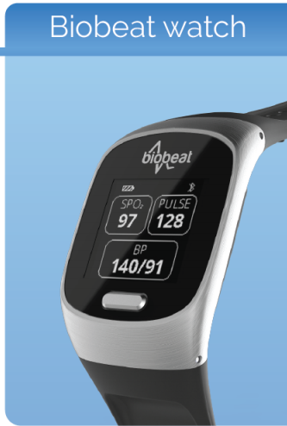
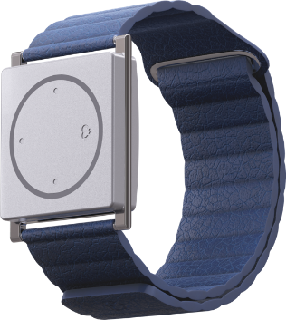
Biophysical Continuous Monitoring Devices
Electrodermal Activity (EDA) measurement of nervous system response
FDA cleared for seizure prediction
Is EDA a surrogate for immune activation?
Sleep, movement
FDA cleared for:
Blood pressure
Pulse rate
Blood oxygenation
21 other parameters

Slide 16


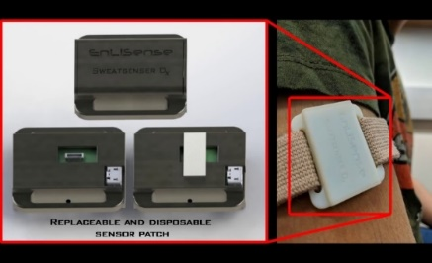
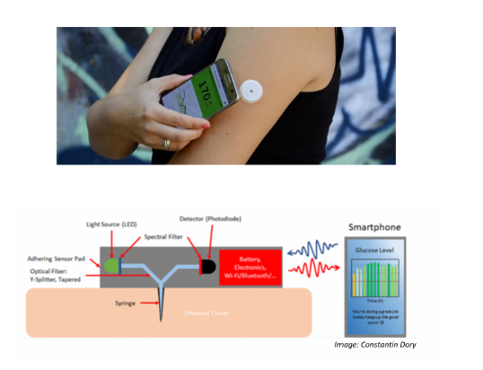
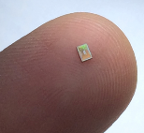
Biochemical Continuous Monitoring Devices
Microneedle patch
Glucose, IP10, TRAIL
Monitors multiple biomarkers every 5 min for 2 weeks
Pre-symptomatic monitoring / drug dose management
Interrogates eccrine sweat - measured every minute for up to 72 hours
IL6, IL8, IL10, TNFa, TRAIL, IP10
Notes:
Track individual health signatures from wellness to illness through non-invasive health monitoring
Partnering with DARPA on clinical studies during Flu season collecting health signature data coupled to pathogen identification and biomarker discovery to identify signs of impending disease

Slide 17
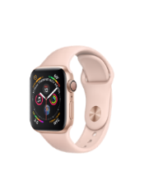
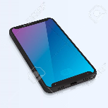
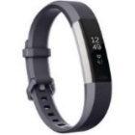
Non-invasive Health Monitoring: Smart App
Couples existing external fitness tracker data (heart rate, ECG, steps, behavioral, geospatial) to phone
“Achievement” app provides daily symptoms questionnaire – couples results with fitness data to predict illness
Notes:
Partnering with Gates and Seattle Flu Study on clinical studies during Flu season collecting health signature data coupled to pathogen identification to identify signs of impending disease
Can greatly enhance public health monitoring for infectious disease
Clinical Study Active now-5250 Patient Cohort monitored daily via Fitbit &
Influenza-like illness (ILI) symptom reports
Once symptomatic, immediate swab at home for rapid Flu testing plus molecular test for 8 viruses that can cause ILI

Slide 18

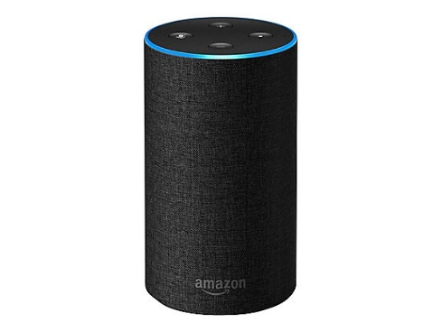
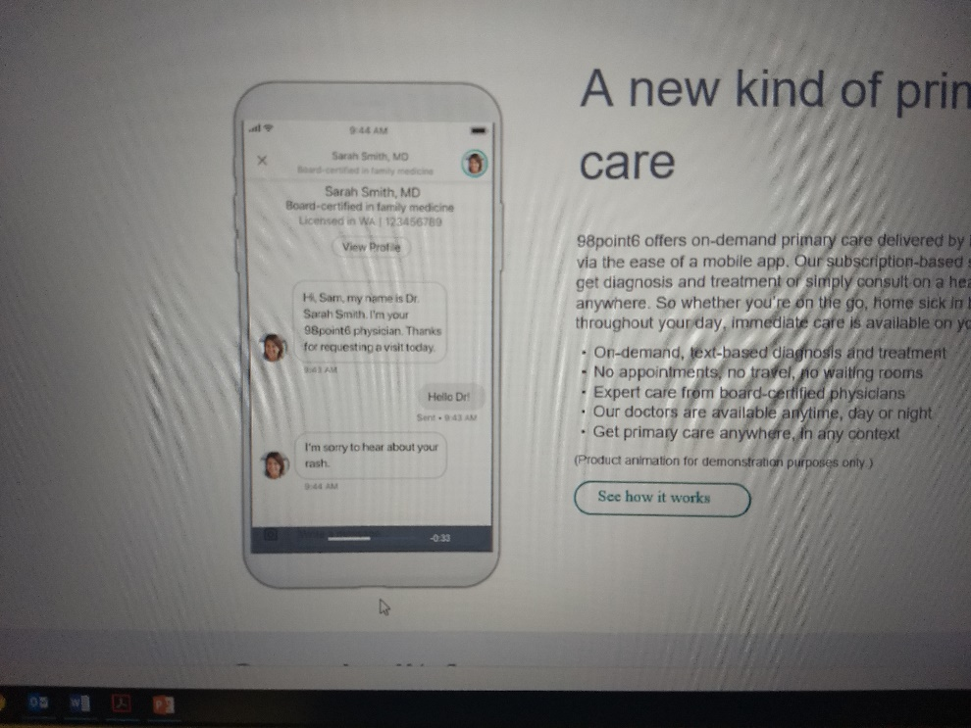
In-Home Monitoring
Telehealth
Software transforms commodity smart devices into active sonar system
Contactless respiratory monitoring
Telemedicine app connects user to board-licensed physician
Real-time epidemic information
Over 500k daily users
Notes:
Sound: Can a home speaker device monitoring breathing predict impending disease?
Software can be readily also applied to Opioid overdose warning (addiction & pain management); aid search & rescue; enhance treatment of chronic ailments
Software transforms commodity smart devices into active sonar system, capable of contactless respiratory monitoring to identify early ARI illness onset.
98.5: Can we use primary care contact cases to enhance the timeliness and efficacy of disease monitoring strategies?
A new approach to primary care, using technology to bring affordable, on-demand access to everyone
Telemedicine provider using smartphone interface to connect patients nationwide to board-certified primary care providers
Potential to provide real time epidemic information and outbreak monitoring of new biological threats to health authorities
Over 500K daily users in all 50 states

Slide 19


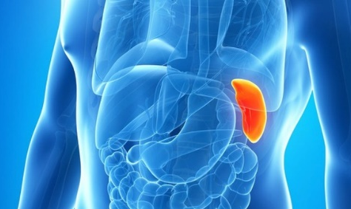
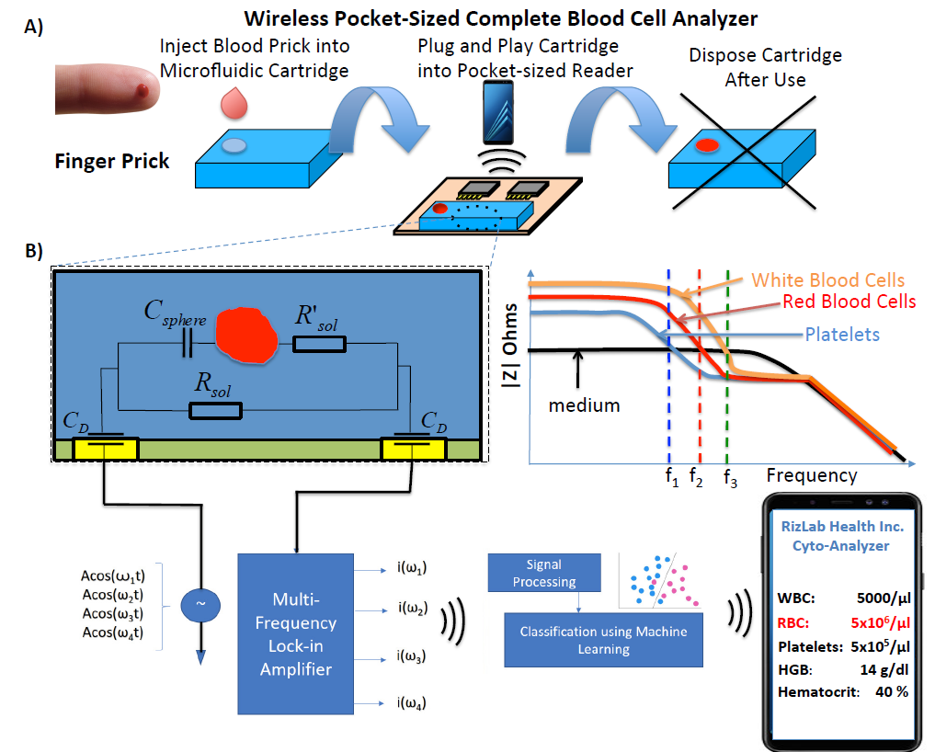
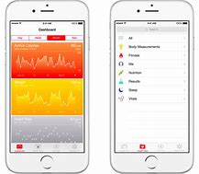
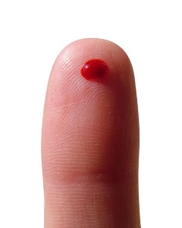

Point-of-Care Analysis
LYMPH
BM1 BM2 BM3
SPLEEN
BM1 BM2 BM3
Pocket-sized blood analyzer determines blood count, immune activation via cell morphology changes
Rapid test to distinguish viral from bacterial infection
Lab-on-a-Dust system (LDS)
CRP, TNF-alpha, IL-1RA
No prep; sample-to-answer: 15 min
Development of stress model involving biomarker signatures
Ultrasound detects changes in biomarker expression / immune cell responses
Tunable antibody switch constructs imbedded in disposable microchip
Notes:
Rizlab Health:
Data-Driven Home Monitoring System for Classifying Viral/Bacterial Infections
Pocket-sized blood analyzer provides CBC at the ER/Physicians’ Office/In The Home Utilizes impedance cytometry to count white blood cells and determine immune activation via morphological changes to those cells
Enables patients to perform a rapid virus/bacteria test to send to their clinician to enhance antibiotic stewardship
Enables first responders to get rapid CBC to enhance potential for life-saving treatments not now available before arrival at hospital
Stanford:
A fully integrated, RF powered, multiplexed, 1mm² MDx system on a disposable CMOS chip immersed in clinical sample and wirelessly transmits results to phone
no sample prep, instrumentation reagents required
Sample to answer: 15 min
Can be used for home-based diagnosis of disease, clinical trial monitoring, rapid triage by emergency responders
Prototype will detect CRP, TNF-a and IL-1RA at [pM] from a finger prick

Slide 20

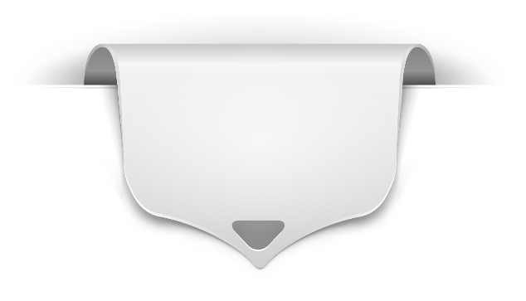





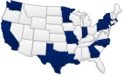


How to Contact BARDA
medicalcountermeasures.gov Portal to BARDA: Register to request a TechWatch meeting!
beta.sam.gov/ Official announcements and info for all government contract solicitations
phe.gov/BARDA Program description, information, news, announcements
drive.hhs.gov Learn about DRIVe, including our Accelerator Network and EZ BAA
www.usajobs.gov Join the team!

